Slide 1
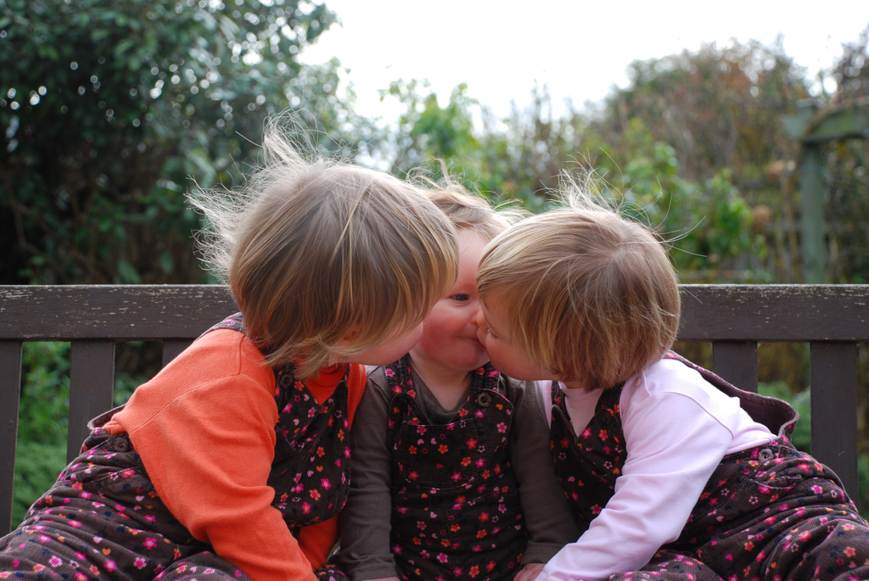

Joint Action
without Shared Intention

Slide 2
What is the relation between a joint action and the goal (or goals) to which it is directed?

Slide 3
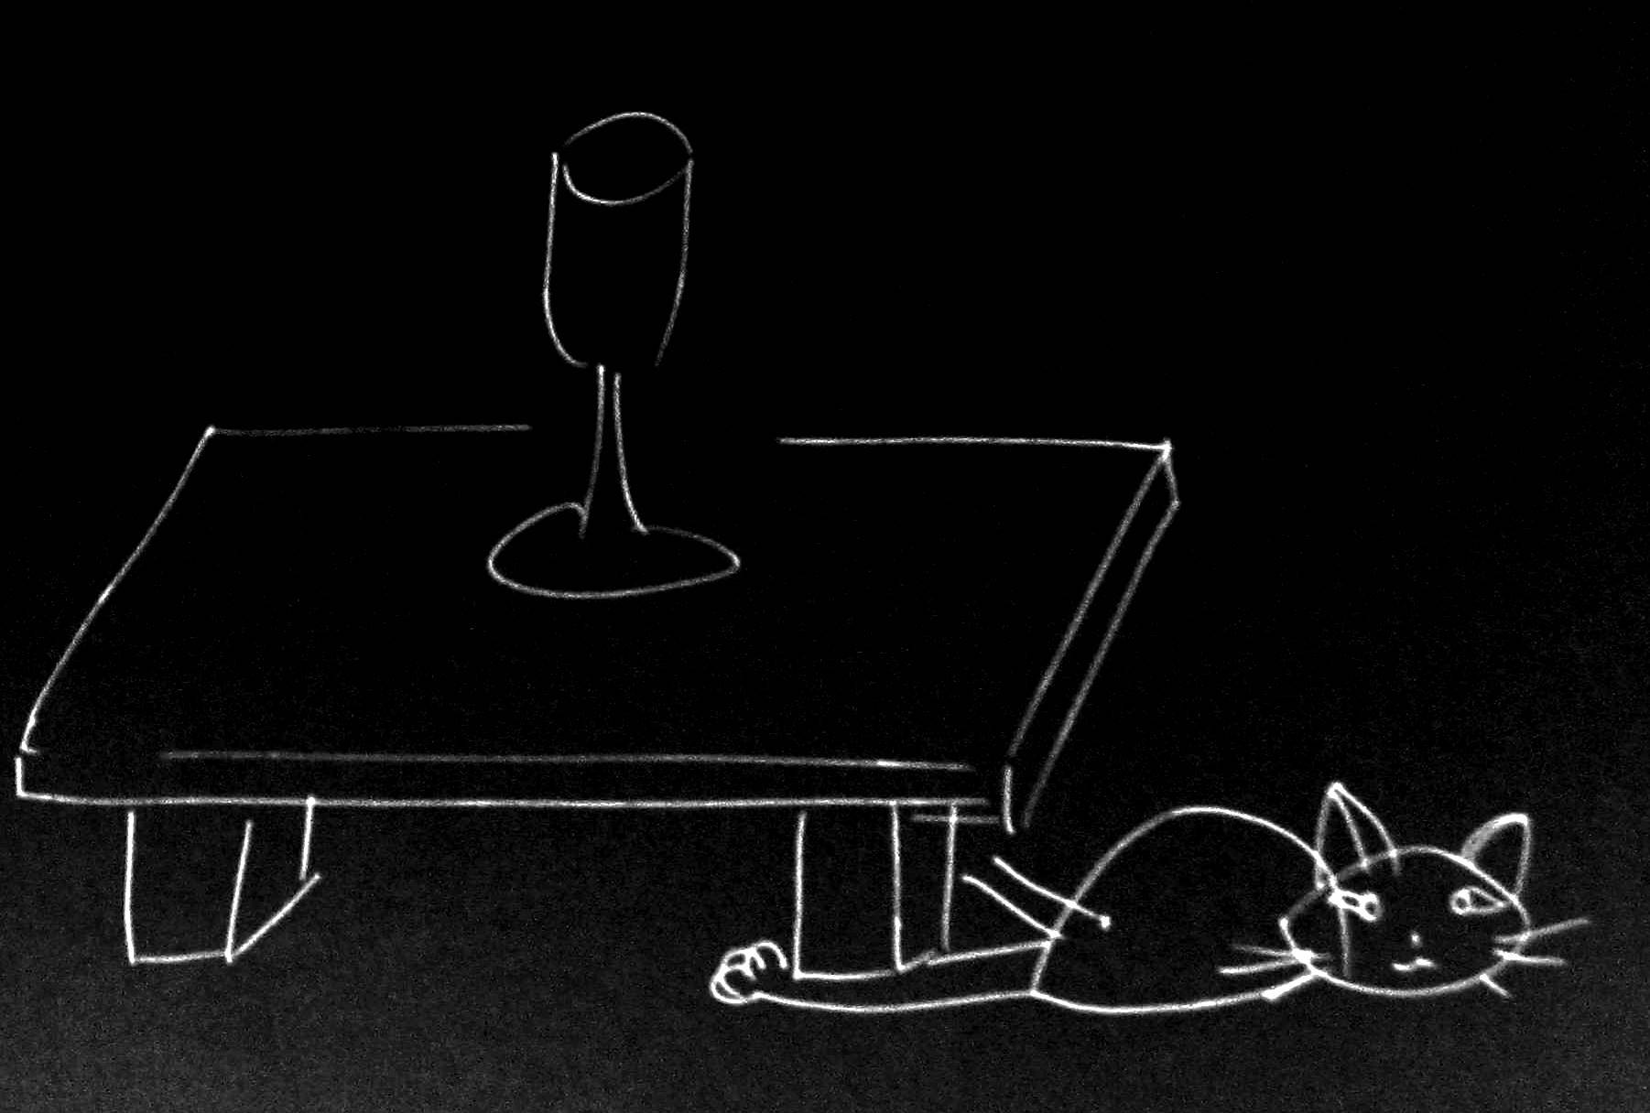
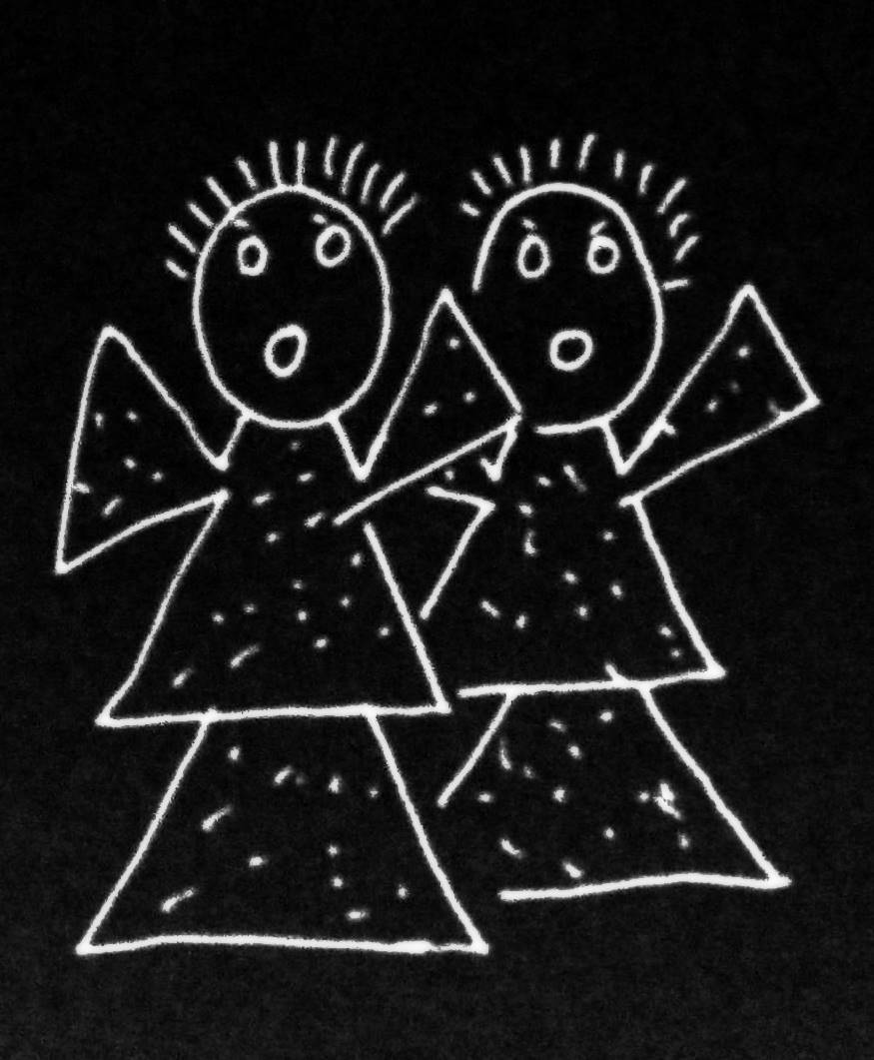
What is the relation between a joint action and the goal (or goals) to which it is directed?

Slide 4
What is the relation between a joint action and the goal (or goals) to which it is directed?

Slide 5
What is the relation between a joint action and the goal (or goals) to which it is directed?

Slide 6

‘I take a collective action to involve a collective [shared] intention.’
‘the key property of joint action lies in its internal component [...] in the participants’ having a “collective” or “shared” intention.’
(Facundo Alonso, 2009, pp. 444-5)

Slide 7
‘I take a collective action to involve a collective [shared] intention.’
‘the key property of joint action lies in its internal component [...] in the participants’ having a “collective” or “shared” intention.’
(Facundo Alonso, 2009, pp. 444-5)

Slide 8
‘I take a collective action to involve a collective [shared] intention.’
The goal of Ayesha and Beatrice’s action is to free the cat.
It is not true that Ayesha and Beatrice have a shared intention to free the cat.

Slide 9
shared intention

Slide 10
awareness of joint-ness
at least one of the agents knows that they are not acting individually; she or they have ‘a conception of themselves as contributors to a collective end.’
awareness of others’ agency
at least one of the agents is aware of one or more of the others as an intentional agent.
awareness of others’ states or commitments
at least one of the agents who are F-ing is aware of, or has individuating beliefs about, some of the others’ intentions, beliefs or commitments concerning F.

Slide 11
awareness of joint-ness
at least one of the agents knows that they are not acting individually; she or they have ‘a conception of themselves as contributors to a collective end.’
awareness of others’ agency
at least one of the agents is aware of one or more of the others as an intentional agent.
awareness of others’ states or commitments
at least one of the agents who are F-ing is aware of, or has individuating beliefs about, some of the others’ intentions, beliefs or commitments concerning F.

Slide 12
awareness of joint-ness
at least one of the agents knows that they are not acting individually; she or they have ‘a conception of themselves as contributors to a collective end.’
awareness of others’ agency
at least one of the agents is aware of one or more of the others as an intentional agent.
awareness of others’ states or commitments
at least one of the agents who are F-ing is aware of, or has individuating beliefs about, some of the others’ intentions, beliefs or commitments concerning F.

Slide 13
awareness of joint-ness
at least one of the agents knows that they are not acting individually; she or they have ‘a conception of themselves as contributors to a collective end.’
awareness of others’ agency
at least one of the agents is aware of one or more of the others as an intentional agent.
awareness of others’ states or commitments
at least one of the agents who are F-ing is aware of, or has individuating beliefs about, some of the others’ intentions, beliefs or commitments concerning F.

Slide 14
awareness of joint-ness
at least one of the agents knows that they are not acting individually; she or they have ‘a conception of themselves as contributors to a collective end.’
awareness of others’ agency
at least one of the agents is aware of one or more of the others as an intentional agent.
awareness of others’ states or commitments
at least one of the agents who are F-ing is aware of, or has individuating beliefs about, some of the others’ intentions, beliefs or commitments concerning F.

Slide 15
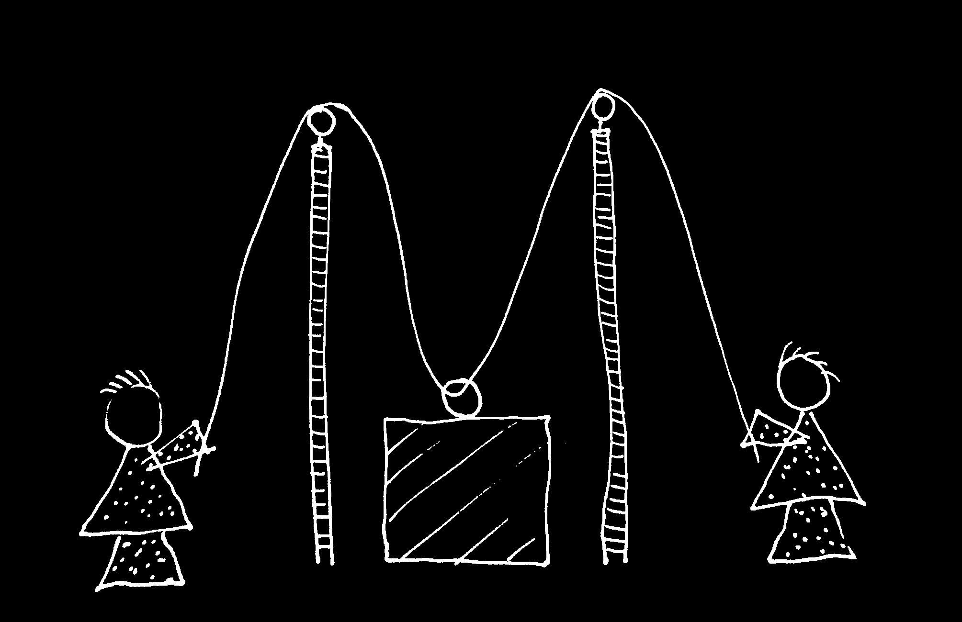
cf. Vesper et al (forthcoming)

Slide 16


Slide 17
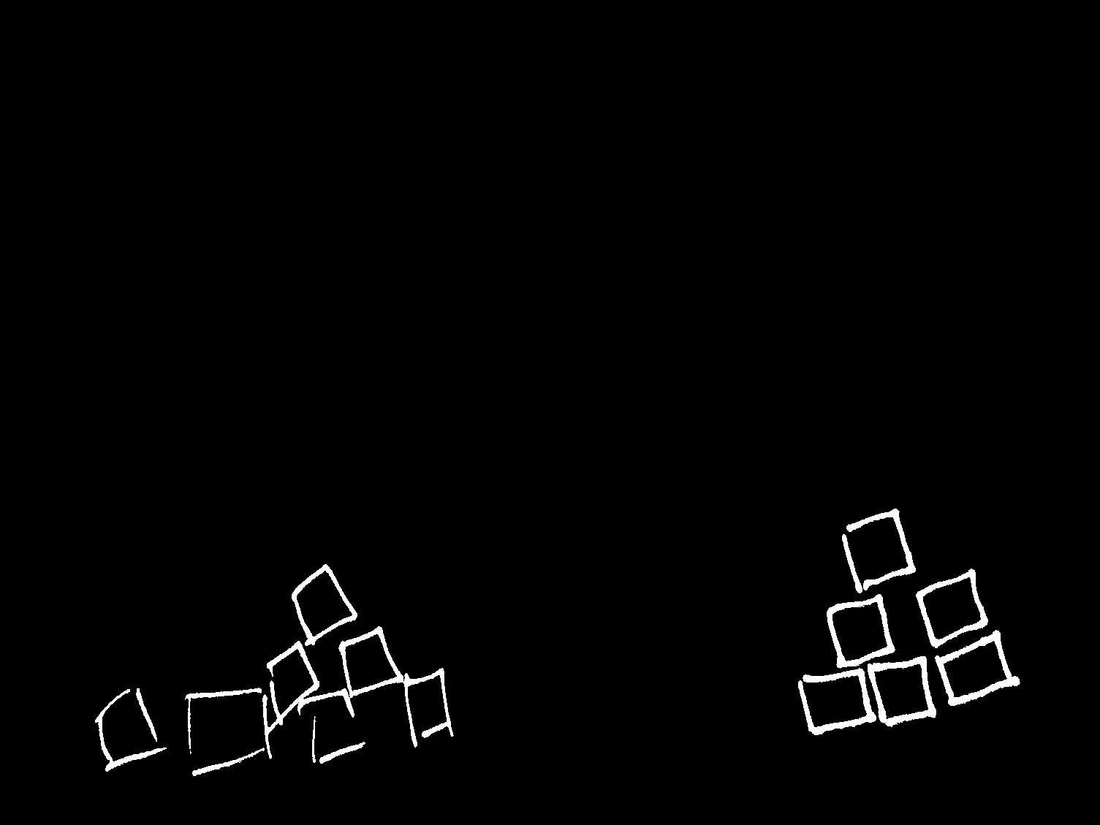

Slide 19
But are they joint actions?

Slide 20
How can we characterise the relation between joint actions and their goal-outcomes without invoking shared intentions?

Slide 21
How can we characterise the relation between joint actions and their goal-outcomes without invoking shared intentions?
---
There is a single goal-outcome such that each agent’s activities are directed to it.

Slide 22
How can we characterise the relation between joint actions and their goal-outcomes without invoking shared intentions?
---
There is a single goal-outcome such that each agent’s activities are directed to it.
This goal-outcome’s obtaining is a common effect of, or is constituted by, all of the agents’ goal-directed activities.

Slide 23
How can we characterise the relation between joint actions and their goal-outcomes without invoking shared intentions?
---
There is a single goal-outcome such that each agent’s activities are directed to it.
This goal-outcome’s obtaining is a common effect of, or is constituted by, all of the agents’ goal-directed activities.
The agents’ activities are coordinated.

Slide 24
How can we characterise the relation between joint actions and their goal-outcomes without invoking shared intentions?
---
There is a single goal-outcome such that each agent’s activities are directed to it.
This goal-outcome’s obtaining is a common effect of, or is constituted by, all of the agents’ goal-directed activities.
The agents’ activities are coordinated.
The goal-outcome occurs partly as a consequence of this coordination

Slide 25
How can we characterise the relation between joint actions and their goal-outcomes without invoking shared intentions?
---
There is a single goal-outcome such that each agent’s activities are directed to it.
This goal-outcome’s obtaining is a common effect of, or is constituted by, all of the agents’ goal-directed activities.
The agents’ activities are coordinated.
The goal-outcome occurs partly as a consequence of this coordination
Notes:
We can weaken the account to include more primitive agents

Slide 26
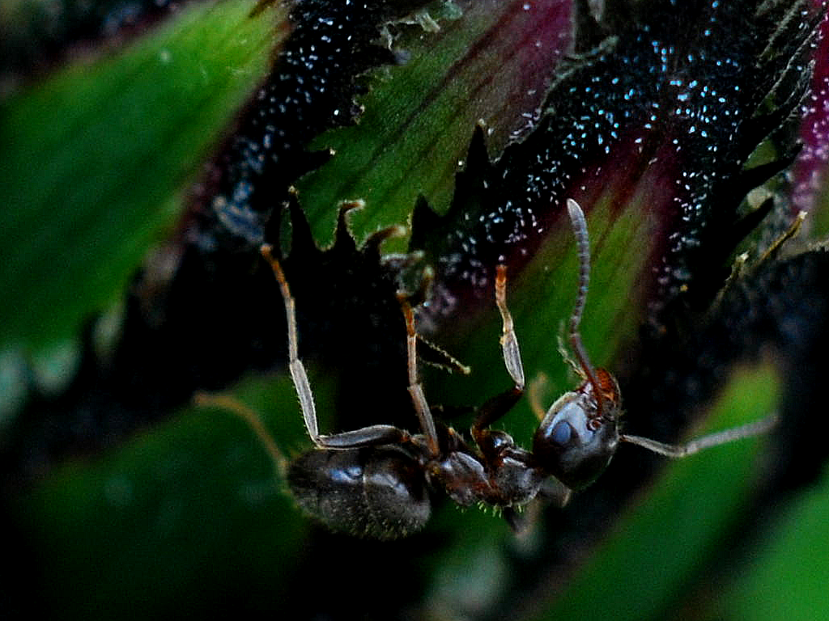

Slide 27
sting
sting
sting
sting
sting
death of fly
sting
sting
sting

Slide 28

‘Ayesha and Beatrice between them lifted the block’

Slide 29
‘Ayesha and Beatrice between them lifted the block’
‘Left Leg and Right Leg between them supported the table’
‘Ayesha and Beatrice between them lifted the block intentionally’

Slide 30
‘Ayesha and Beatrice between them lifted the block’
‘Left Leg and Right Leg between them supported the table’
‘Ayesha and Beatrice between them lifted the block intentionally’

